Slide 1

Mr. Mark Arnold can provide free assistance with making a planned gift to support the gospel ministry of our congregation, synod, and WELS-affiliated ministries.
Call him at 920-450-9587 or
e-mail mark.arnold@wels.net
Notes:
Using these slides: Every WELS congregation has two WELS Christian giving counselors assigned to it – one current giving specialist (cash, appreciated assets) and one deferred giving specialist (estate planning, planned gifts). These slides allow you to introduce your congregation’s counselors to members so that they can work with them for their giving needs for the benefit of your church, regional WELS ministries, and the synod. The slides are in alphabetical order by last name and show the counselor’s specialty and the district(s) he serves. (In the Minnesota District there are two current and two deferred counselors serving different regions of the district. To verify exactly which counselors serve your congregation, call WELS Ministry of Christian Giving at 414-256-3209 / 800-827-5482.) Once you know your counselors, copy and paste those two slides (or delete all but the two slides that you need).
Mark Arnold is the deferred counselor for the South Atlantic and South Central Districts.

Slide 2

Rev. Nathan Cordes can provide free assistance with making a planned gift to support the gospel ministry of our congregation, synod, and WELS-affiliated ministries.
Call him at 651-448-3559 or
e-mail nathan.cordes@wels.net
Notes:
Nathan Cordes is the deferred counselor for the Dakota-Montana and Nebraska Districts and the southern part of the Minnesota District.

Slide 3

Rev. Jim Fleming can provide free assistance with making a planned gift to support the gospel ministry of our congregation, synod, and WELS-affiliated ministries.
Call him at 920-419-1757 or
e-mail jim.fleming@wels.net
Notes:
Jim Fleming is the deferred counselor for the Northern Wisconsin District.

Slide 4

Rev. Jerry Ewings can provide free assistance with making a planned gift to support the gospel ministry of our congregation, synod, and WELS agencies.
Rev. Michael Hatzung can provide free assistance with making a planned gift to support the gospel ministry of our congregation, synod, and WELS-affiliated ministries.
Call him at 608-630-7857 or
e-mail jerry.ewings@wels.net
Call him at 612-280-4491 or
e-mail michael.hatzung@wels.net
Notes:
Michael Hatzung is a deferred counselor for the northern part of the Minnesota District.

Slide 5

Rev. Jerry Ewings can provide free assistance with making a planned gift to support the gospel ministry of our congregation, synod, and WELS agencies.
Mr. Terry Helton can provide free assistance with making a planned gift to support the gospel ministry of our congregation, synod, and WELS-affiliated ministries.
Rev. Michael Hatzung can provide free assistance with making a planned gift to support the gospel ministry of our congregation, synod, and WELS agencies.
Call him at 608-630-7857 or
e-mail jerry.ewings@wels.net
Call him at 262-945-1563 or
e-mail terry.helton@wels.net
Call him at 612-280-4491 or
e-mail michael.hatzung@wels.net
Notes:
Terry Helton is the deferred counselor for the Michigan and North Atlantic Districts.

Slide 6

Rev. Jonathan Kehren can provide free assistance with making a planned gift to support the gospel ministry of our congregation, synod, and WELS-affiliated ministries.
Call him at 312-315-5958 or
e-mail jon.kehren@wels.net
Notes:
Jonathan Kehren is the deferred counselor for the Western Wisconsin District.

Slide 7

Mr. Ralph LePore can provide free assistance with making a planned gift to support the gospel ministry of our congregation, synod, and WELS-affiliated ministries.
Call him at 702-587-3874 or
e-mail ralph.lepore@wels.net
Notes:
Ralph LePore is the deferred counselor for the Arizona-California and Pacific Northwest Districts.

Slide 8

Mr. Scott Wagner can provide free assistance with making a planned gift to support the gospel ministry of our congregation, synod, and WELS agencies.
Rev. Paul Lindhorst can provide free assistance with making a planned gift to support the gospel ministry of our congregation, synod, and WELS-affiliated ministries.
Call him at 605-231-7402 or
e-mail scott.wagner@wels.net
Call him at 605-880-1583 or
e-mail paul.lindhorst@wels.net
Notes:
Paul Lindhorst is the current counselor for the Southeastern Wisconsin District.

Slide 9

Mr. Patrick Ruehrdanz can provide free assistance with making a planned gift to support the gospel ministry of our congregation, synod, and WELS-affiliated ministries.
Rev. Thomas Mielke can provide free assistance with making a planned gift to support the gospel ministry of our congregation, synod, and WELS-affiliated ministries.
Call him at 847-370-8812 or
e-mail patrick.ruehrdanz@wels.net
Call him at 920-750-4803 or
e-mail thomas.mielke@wels.net
Notes:
Patrick Ruehrdanz is the current counselor for the Northern Wisconsin District.

Slide 10

Rev. Steve Schmeling can provide free assistance with making a planned gift to support the gospel ministry of our congregation, synod, and WELS-affiliated ministries.
Call him at 612-222-2050 or
e-mail steve.schmleing@wels.net
Notes:
Steve Schmeling is the current counselor for the Dakota-Montana and Nebraska Districts, and the southern part of the Minnesota District.

Slide 11
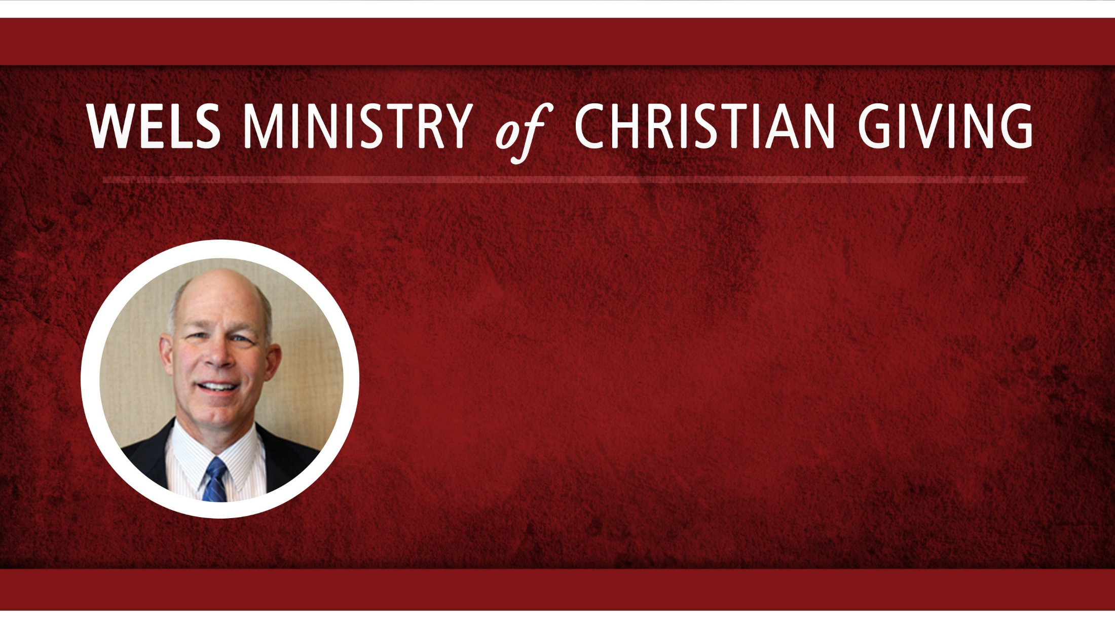
Rev. Phil Spaude can provide free assistance with making a planned gift to support the gospel ministry of our congregation, synod, and WELS-affiliated ministries.
Call him at 612-720-1323 or
e-mail philip.spaude@wels.net
Notes:
Phil Spaude is the current counselor for the northern part of the of the Minnesota District.

Slide 12

Rev. Daniel Wagenknecht can provide free assistance with making a planned gift to support the gospel ministry of our congregation, synod, and WELS-affiliated ministries.
Call him at 714-624-9001 or
e-mail daniel.wagenknecht@wels.net
Notes:
Daniel Wagenknecht is the current counselor for South Atlantic and South Central Districts.

Slide 13

Mr. Scott Wagner can provide free assistance with making a planned gift to support the gospel ministry of our congregation, synod, and WELS-affiliated ministries.
Call him at 605-231-7402 or
e-mail scott.wagner@wels.net
Notes:
Scott Wagner is the deferred counselor for the Southeastern Wisconsin District.

Slide 14

Rev. Craig Wasser can provide free assistance with making a planned gift to support the gospel ministry of our congregation, synod, and WELS-affiliated ministries.
Call him at 503-990-1058 or
e-mail craig.wasser@wels.net
Notes:
Craig Wasser is the current counselor for the Arizona-California and Pacific Northwest districts.

Slide 15

Mr. Mark Werre can provide free assistance with making a planned gift to support the gospel ministry of our congregation, synod, and WELS-affiliated ministries.
Call him at 608-606-2851 or
e-mail mark.werre@wels.net
Notes:
Mark Werre is the current counselor for the Western Wisconsin District.

