Slide 1



Slide 2

PLEASE PRAY for the leaders of the Apache churches; that the members continue to find ways to serve those locked in cycles of addiction, poverty and despair; and that God would bless the many laymen and laywomen who help with these vital ministries locations.

Slide 3
THROUGH YOUR CONGREGATION MISSION OFFERINGS AND SPECIAL OFFERINGS the people of Apacheland are receiving God’s Word. Thank you for supporting this ministry.

Slide 4
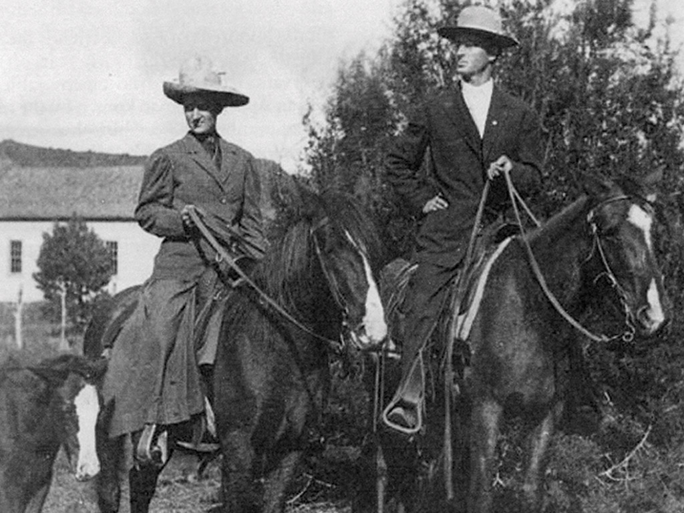

WELS MISSION EFFORTS BEGAN IN EASTERN ARIZONA IN 1893.

Slide 5
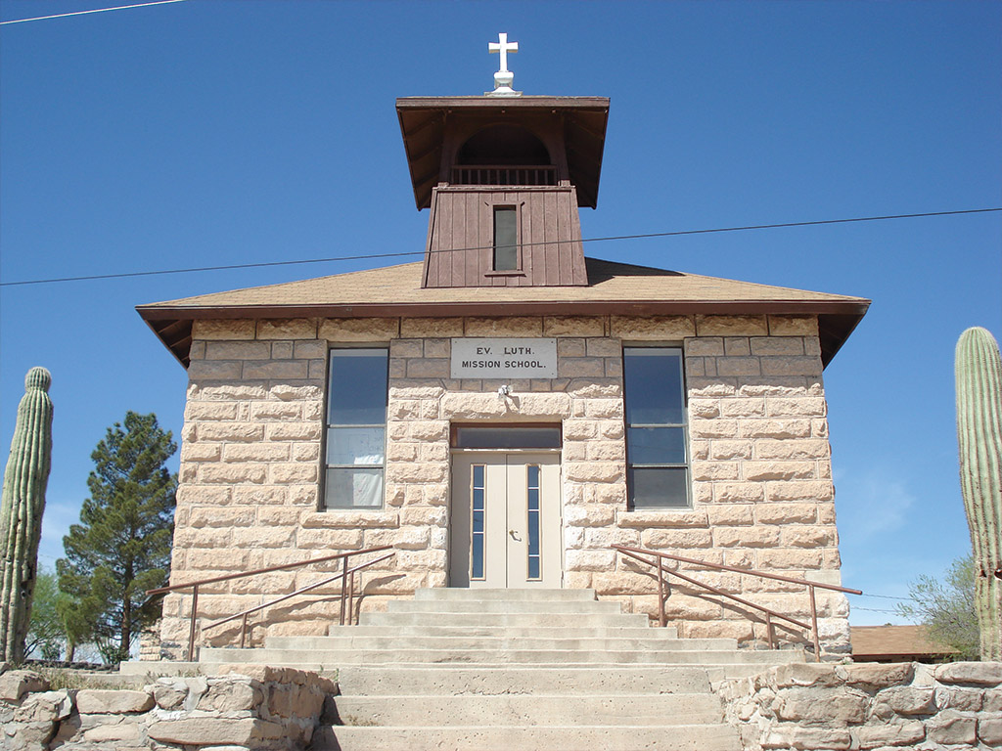
APACHELAND IS WELS’ FIRST WORLD MISSION FIELD

Slide 6
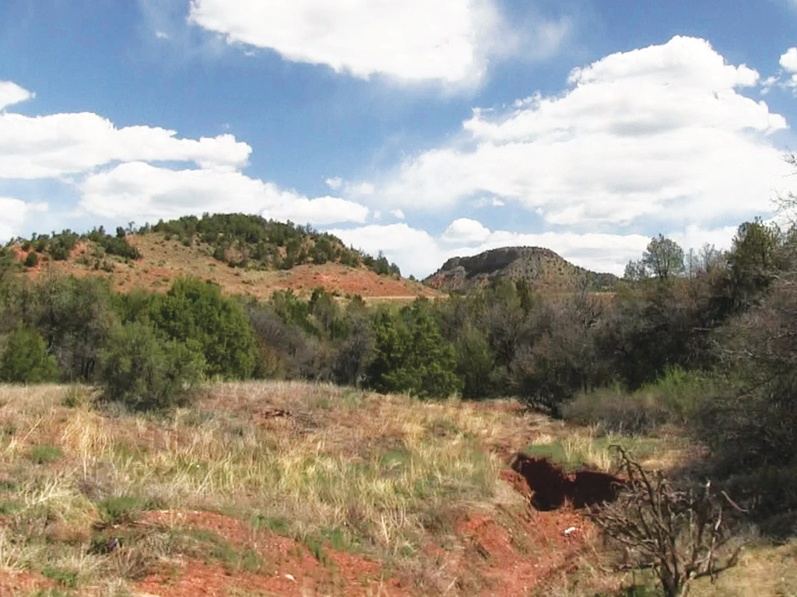
JESUS IS PROCLAIMED ON THE WHITE MOUNTAIN AND
SAN CARLOS RESERVATIONS

Slide 7
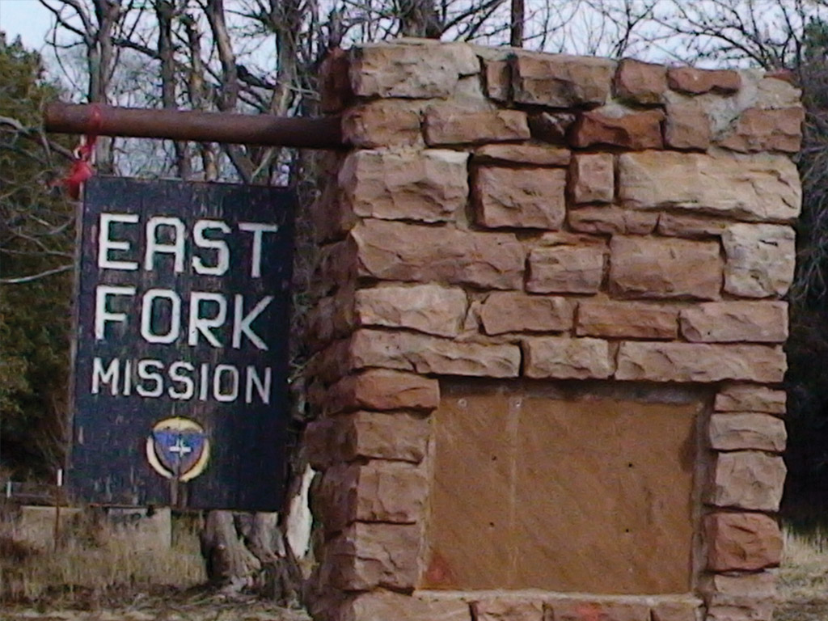
A WELS MISSION FOR
MORE THAN 100 YEARS

Slide 8
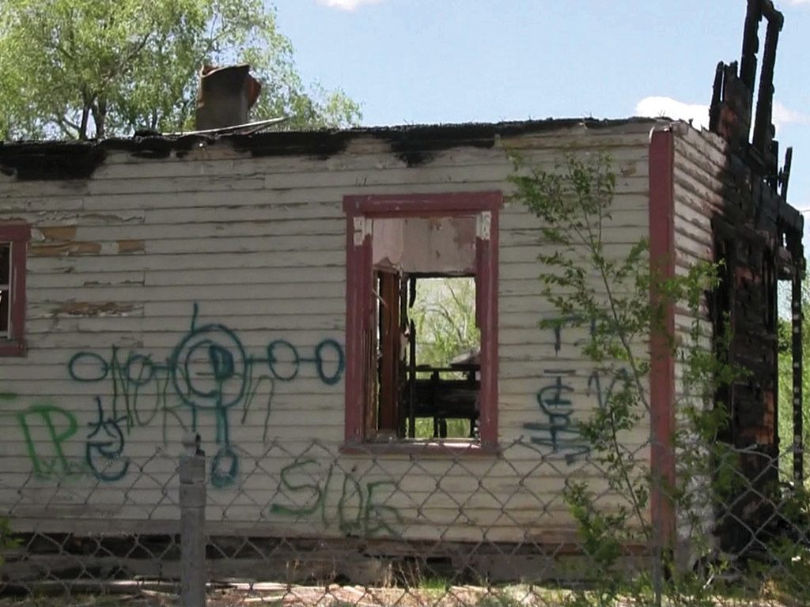
EVANGELISM HAS CHALLENGES; THERE ARE MANY OBSTACLES

Slide 9
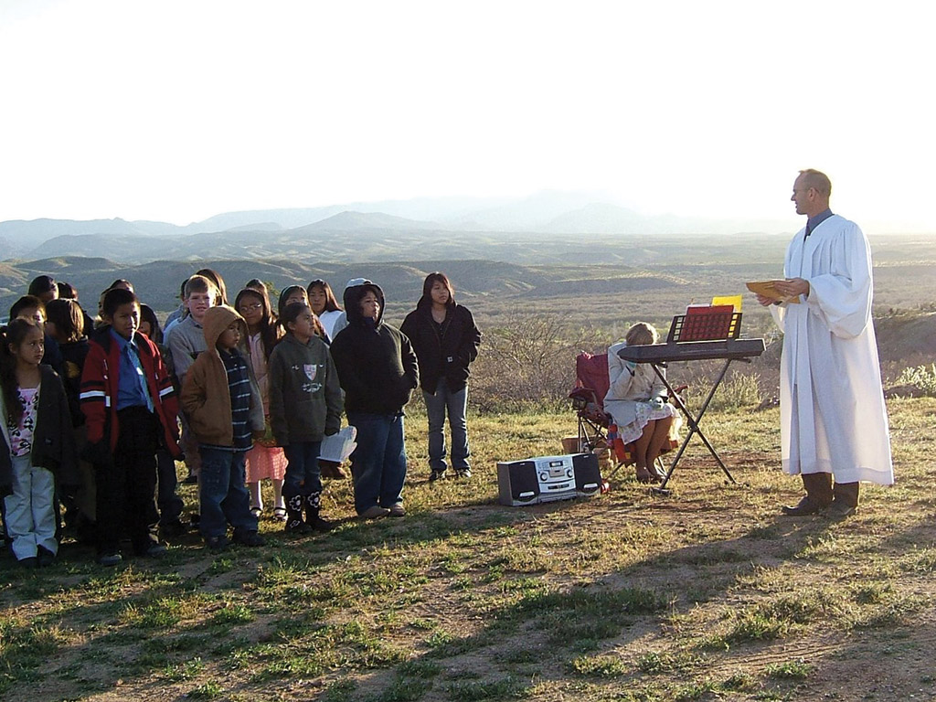
MORE THAN 3,500
BAPTIZED MEMBERS IN SPITE
OF CHALLENGES

Slide 10
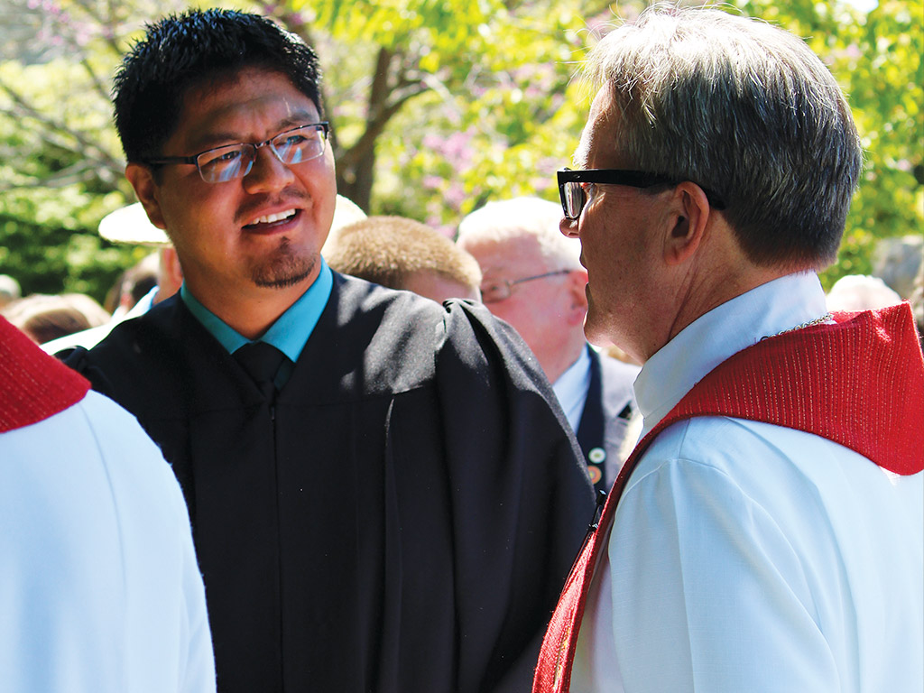
TWO NATIONAL PASTORS SERVE THE APACHE PEOPLE

Slide 11
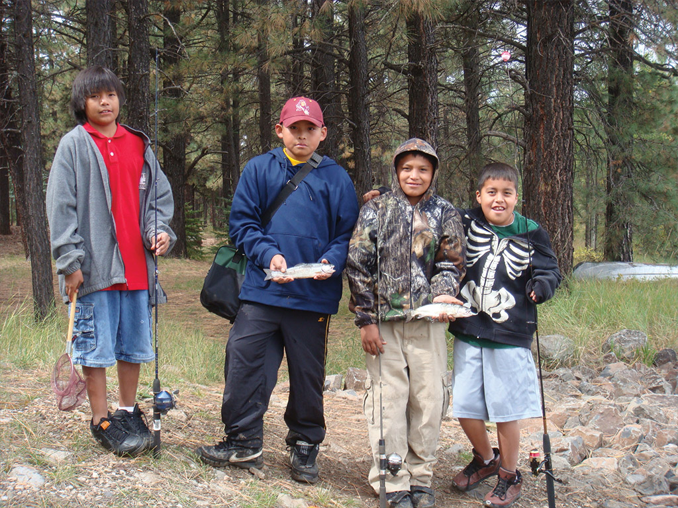
EIGHT ORGANIZED CONGREGATIONS

Slide 12
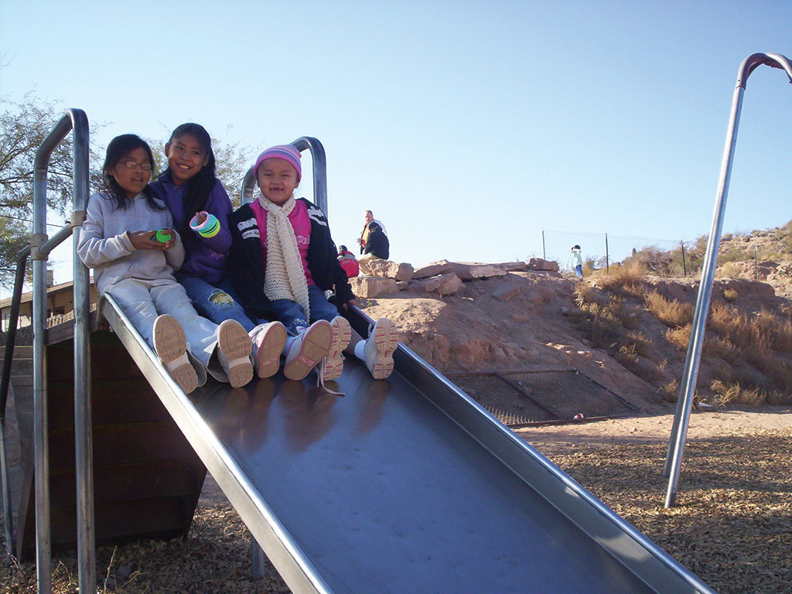
TWO LUTHERAN SCHOOLS

Slide 13


Slide 14
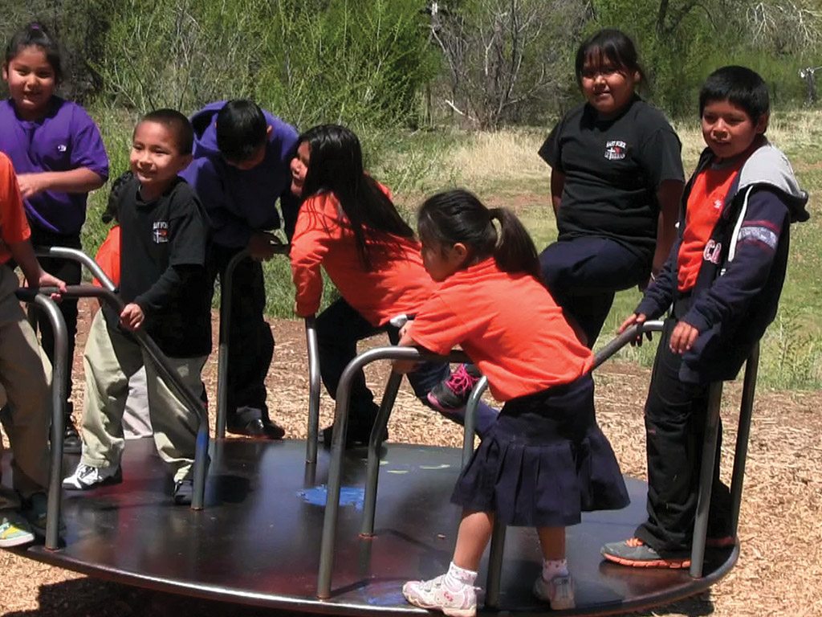
NINE TEACHERS, THREE OF THEM APACHE

Slide 15
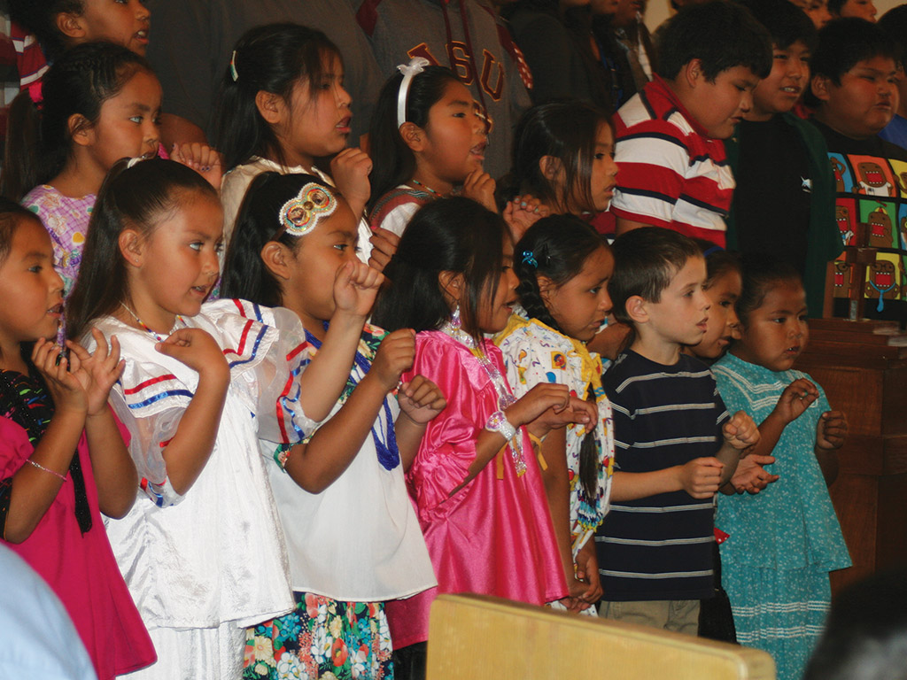
APACHE MINISTRY
IS CHANGING

Slide 16

NATIVE AMERICANS ARE BECOMING LEADERS OF THEIR CHURCH

Slide 17


Slide 18


Slide 19
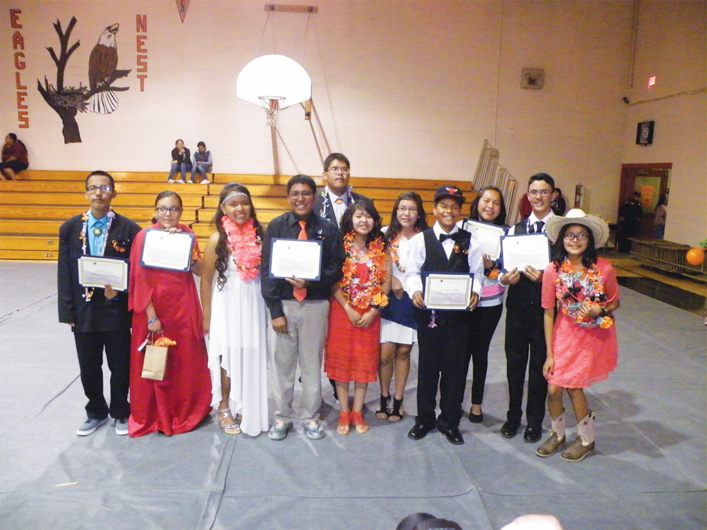
FUTURE APACHE EVANGELISTS, TEACHERS, AND PASTORS

Slide 20

Apacheland is featured in the September 2015 issue of Forward in Christ magazine.
Find out more at www.wels.net/
forwardinchrist

Slide 21


